Slide 1
Lecture 11
DAOs and Governance

Slide 2
DAO - A definition
Decentralized - Everybody gets to voice their opinion. No hierarchy or authority.
Autonomous - Able to take action and achieve goals without a stamp of approval
Organisation - A community working towards a common goal instead of paid labour

Slide 3
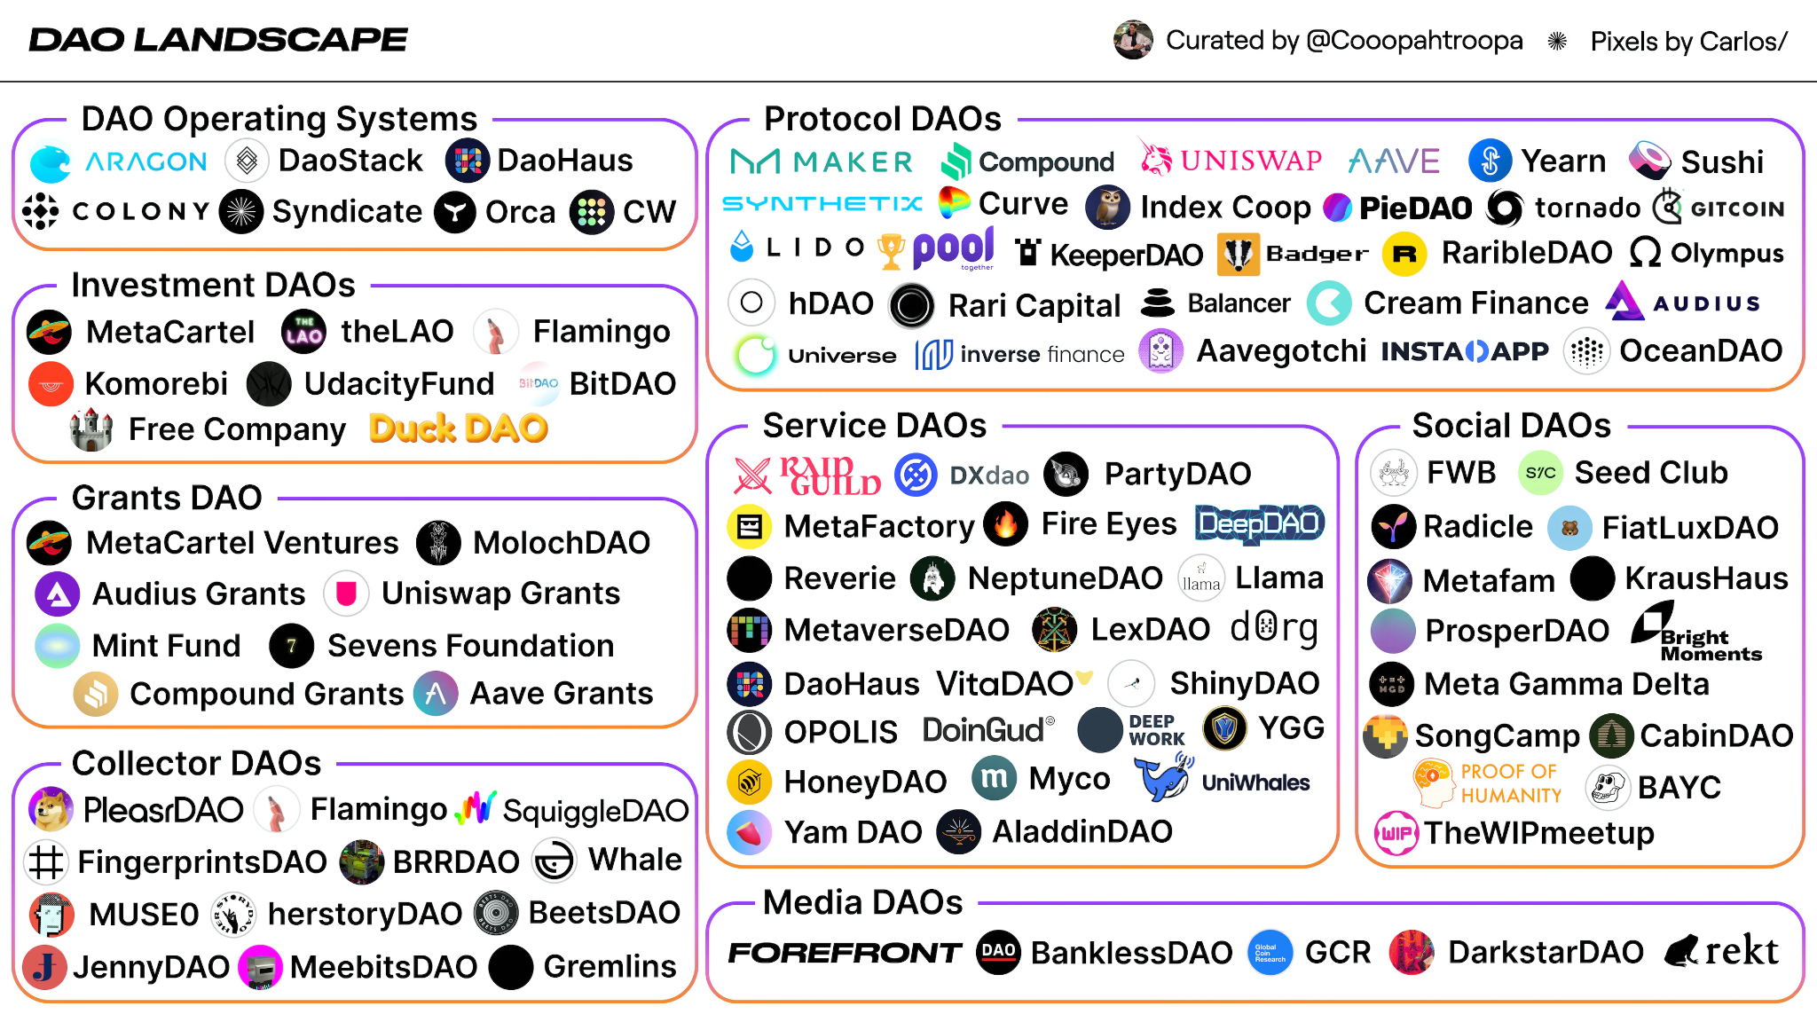
DAO landscape
Notes:
DAO OS - DAO as a service. Create your DAO with no code
Collector DAO - Artistic DAO, curate a gallery, manage ownership
Service DAO - DAO as a service - treasury management, community management, security of DAOs
Social DAO - DAO form of web 2 social media. Connects people for certain goals. Linkedin for work. Facebook for friendship, tinder for dating
Media DAOs - content DAOs. education content, podcast, media. Rekt news threads

Slide 4
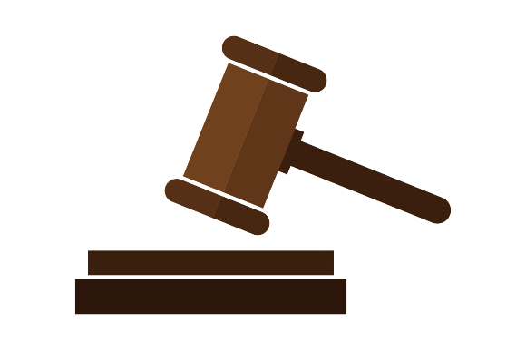

The two pillars of DAOs
Governance Model
Treasury Management
The management of voting and proposal lifecycle management. (Lecture 1 EIP process)
- Tools used to discuss and post proposals.
- Voting mechanisms to ensure fair representation and avoid token manipulation
- Timelocks and execution processes of passed proposals
Managing funds and tokenomics of the DAO
- Manage asset portfolio and value volatility of the treasury
- Secure smart contract for treasuries
- Native-token tokenomics

Slide 5
DAO lifecycle and tooling
Discussion
&
Proposal
Governance Mechanism
Proposal Execution
Community
Mission
Define the purpose of your DAO and the target audience it serves.
.
Define the success metrics and ROI.
Token distribution and delegation
Have a place where people can freely exchange. A sense of community builds loyalty
.
Forum; Orbit; Community as a Service?
Onchain - history, transparency but gas fees
.
Offchain - fast, no gas, needs a separate onchain execution call
Eligibility, Token Power, Duration
Timelocks
Rage Quit (trade with treasury)
Who has power to execute?
Result feedback?
Notes:
Hybrid voting exists too!

Slide 6
DAO treasuries
Valuation and Asset Portfolio of DAO treasuries
Holding one token type - ok if multiple treasuries?
Governance token separate from native/utility token?
Perform yield earning activities with treasury?
Secure Storage and Execution
Who owns the purse strings? A single person, an entity or a smart contract?
Multisig Wallets
  A wallet which requires a certain number of addresses to sign before execution.
  Can be a specific number of signatures or a percentage out of the whole

Slide 7
Regulation - Legal & Fiscal
The US has made an attempt to recognise DAOs
Wyoming became the first state to recognise DAOs on 1 July 2021. Legal definition here.
Similar in status to LLC but with a certain % of governance done by Smart Contracts, membership based on token ownership and enforced dissolution if DAO does not pass any proposals in 1 year.
A number of other US states have created similar legislation.
The EU is still undecided and highly fragmented
Germany - Crypto vested for more than 1 year is tax free!
France - very complex - categorized by mining, trading and corporate gains. Tax Law.
Non official status in the EU. Most registered as an "association". Provides basic legal protection for private individuals.
MakerDAO - are they truly a DAO?
  Has a stablecoin, do not rely on donations
  Has a treasury worth $1.2Billion
  Pays salaries to its core employees
  Has income statements with revenue and expenses….

Slide 8
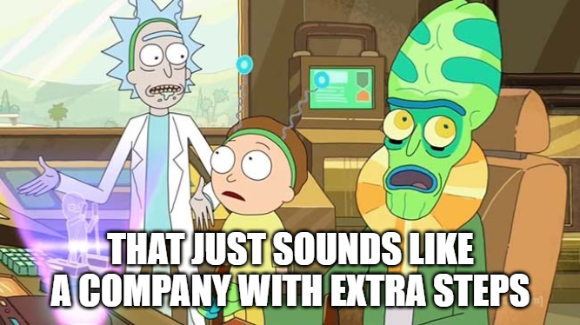

Slide 9
MiCA - Markets in Crypto Assets
Standardizing EU wide regulation on crypto assets and companies. Full text.
Published in OJEU
MiCA is approved with consultation and transitional periods. Countries trial and provide feedback. Attempt to bring existing local laws in line with MiCA.
Package 2 - CASP responsibilities
Sustainability and profitability requirements.
Operational and accounting practices.
Duty to the public.
Stablecoin Regulation
Title III (asset backed tokens) and Title IV (e-money tokens) comes into effect
July 2023
Q1 2024
December2024
June 2023
October2023
June 2024
Package 1 - CASPs and NCAs
Service providers must register with national crypto associations.
Establish application, complaint and appeal procedures.
Package 3 - Protection
Cyber and consumer protection. Qualification of project assets. Laws on monitoring, detection and reporting of abuse and malpractice.
Full enactment
Token types, company classifications, market abuses.
Standardization across the EU.

Slide 10
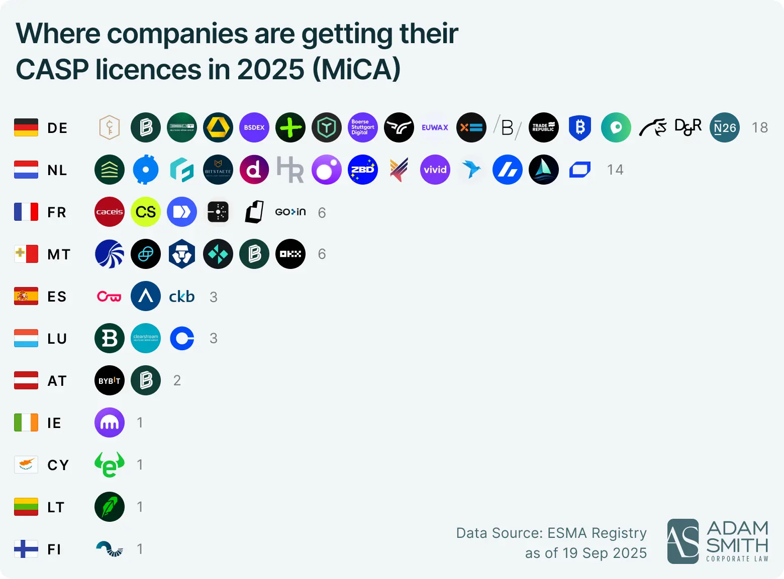
How is it going so far?

Slide 11

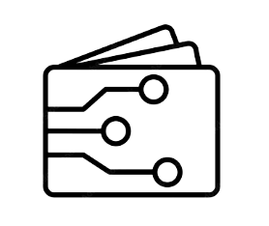



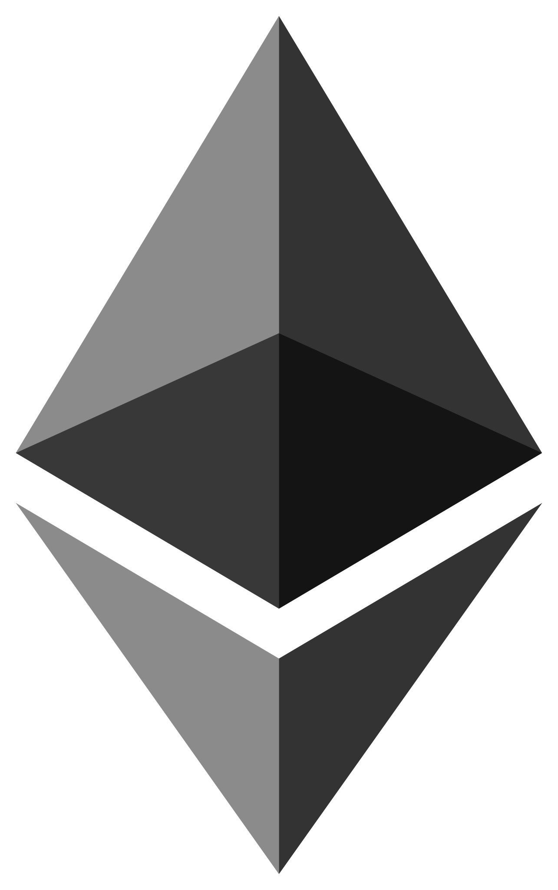
ConstitutionDAO - An example
A DAO that lived for 7 days, existing fo the sole purpose of purchasing an original copy of the US Constitution
Community was solely managed through Discord. The mission was simply: Putting the Constitution in People's hands
Created a Multisig Wallet. 7/13 Signatures required. Community distrust due to anonymity. Signers volunteered identity.
Created the $PEOPLE token. Exchange ETH for $PEOPLE. Voting rights to what to do after Constitution was purchased.

Slide 12
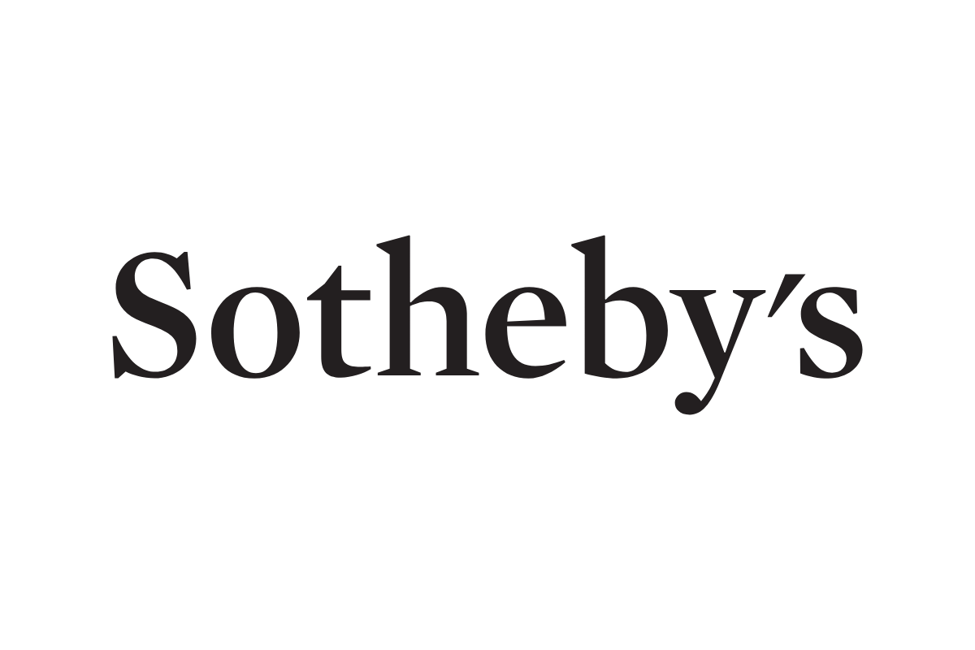
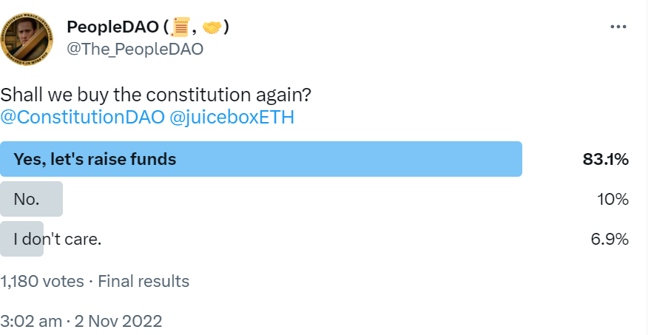
ConstitutionDAO - Result
Raised $47Mil in 7 days. Gained confidence from Sotheby to participate.
Result: Failed to win auction
Full refunds were given on Juicebox at a hard pegged rate of 1ETH : 1Mil PEOPLE.
Varying strategies - get ETH back, hodl PEOPLE tokens for round 2.
In the end, no voting was ever done on the DAO since they failed to purchase the Constitution. However in December 2022… Round 2 starting on Twitter!

Slide 13
Voting Power
Notes:
Every device we have today is a turing machine and Ethereum operates on similar principles

Slide 14
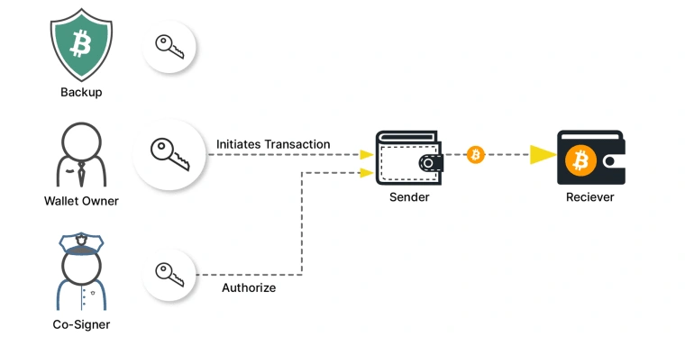
Multisig wallets - signing power
n-of-m scheme where transactions are executed upon reaching required n.
Nice code examples: https://solidity-by-example.org/app/multi-sig-wallet/
Do you trust your collaborators?
  Harmony hack - $100M - Server holding private key compromised
  Parity - library self-destructed, contract ownership seized
  Axie DAO - engineers looking for new job

Slide 15
Wallet types
No code era
Smart Contract wallets
Software Wallets - Metamask. A software which generates private and public key pairs. - Additional front end features like displaying NFTs, organizing tokens into a portfolio, etc. - Can be non-custodial or custodial | Account Abstraction Wallets - Serves as a layer of abstraction between web3 and web2 - allow Email, Google, Facebook logins - Processes and emits pseudo-transactions
Hardware Wallets - USB key holding private and public keys. - Command line query of information. - Safer from social engineering attacks? | Multi-Sig Wallets - Custom transactions requiring threshold of confirmations - Maintenance of owners list in contract

Slide 16
Token Based Voting
Have a token contract
  ERC20 - quantity of fungible tokens
  ERC721 - NFT holders go on allowlist
  ERC5805 - vote and delegation tracking through NFT-like metadata
Decide the weight of each token
Check the token balance of each account in contract
Greatest token weight wins.
Pros
Voters are financially invested
Don't need to KYC wallet addresses and prevent sybil attacks
Cons
Flash loan for voting tokens
Usually whales, ie. investors, hold majority - plutocracy
Token trading / double counting

Slide 17
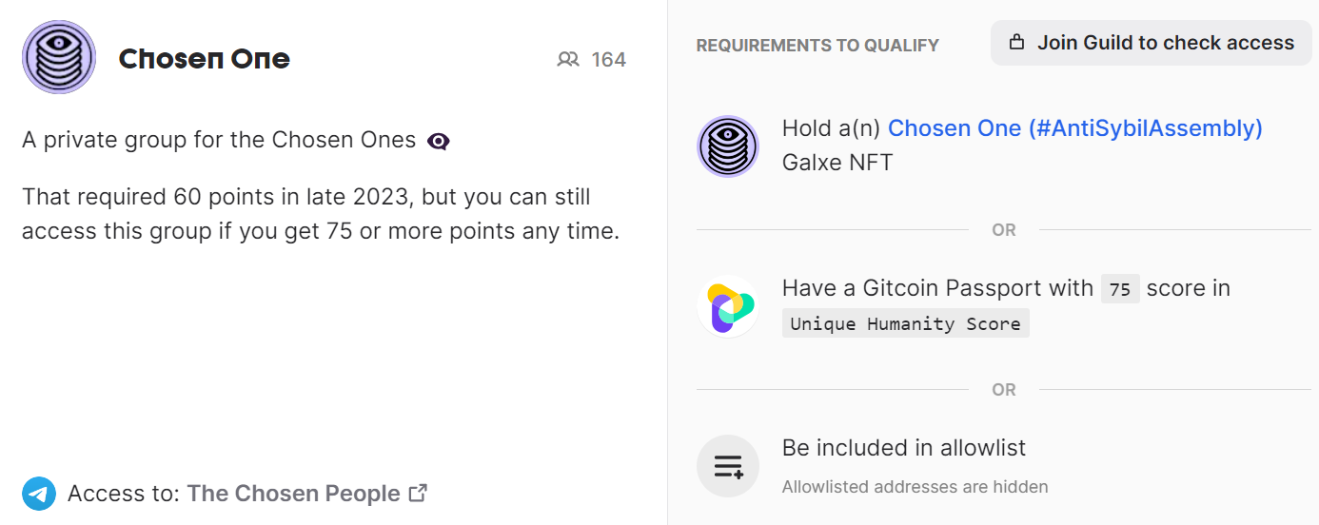
Who are the voters?
Can identity be associated to wallet addresses? - Social Engineering
Voting history is fully transparent, an identity doxx would be bad.
Currently using allowlist contracts, Token ownerships, but ZK Proofs allow for full masking of identity!

Slide 18
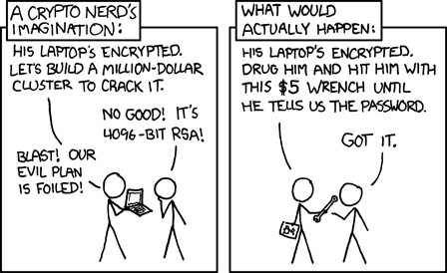
A hacker's POV - Go for lowest hanging fruit

Slide 19
Voting Strategies
Notes:
Every device we have today is a turing machine and Ethereum operates on similar principles

Slide 20
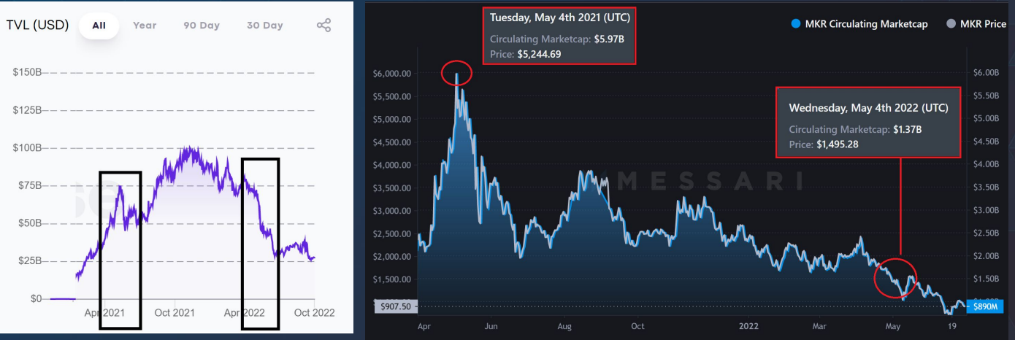
Perceived image matters
https://archive.devcon.org/resources/6/2022-statistics-on-makerdao-voter-delegation.pdf

Slide 21
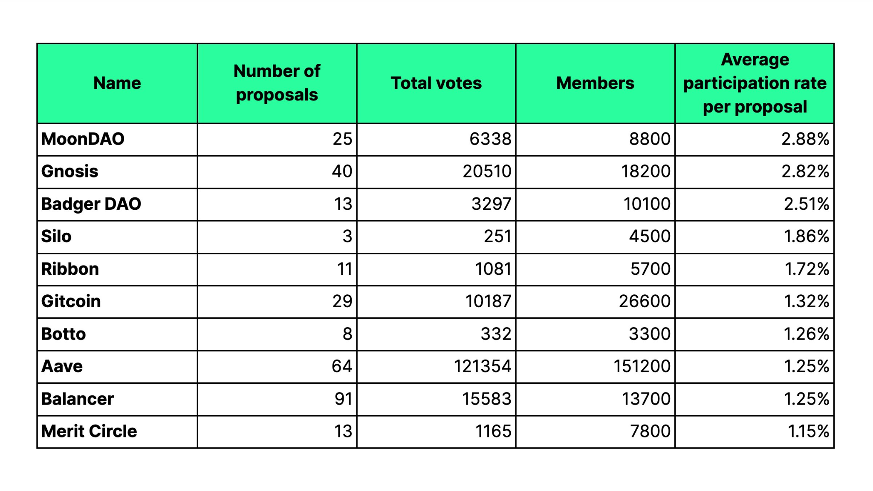
Struggling with voter apathy

Slide 22
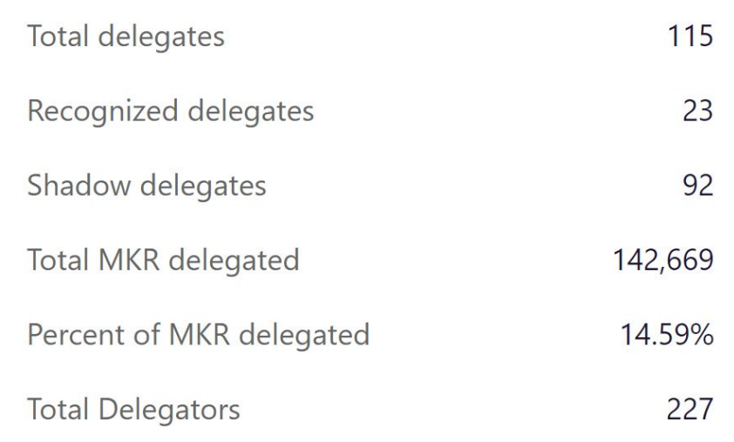
Token (power) delegation
Mostly investors hold the greatest voting power.
  Are they delegating to parties with similar beliefs. Is this real power sharing?
  Delegates have their own incentives and motivations as well. Bribery?
Investors generally have more financial expertise.
  Some DAOs lock important decisions for core members only
Recognized vs Shadow Delegates
  Delegating to arbitrary players?
Token Delegation contract / extension
  Cannot delegate if already voted
  Who pays gas fees?
  Prevent further delegation / double voting
  auto undelegate functionality, lockups

Slide 23
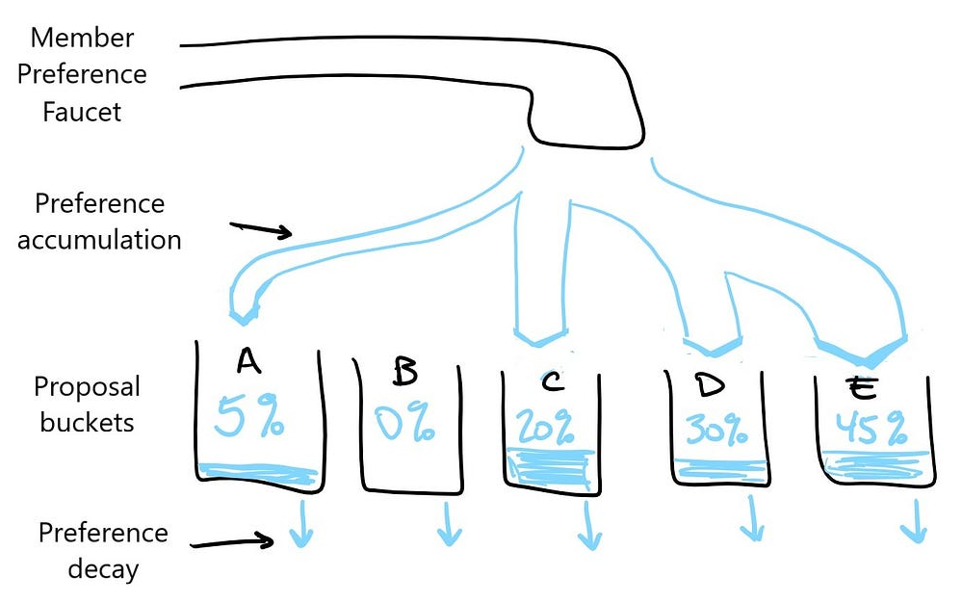
Conviction voting
Intensity of certainty
Delegation is still a small percentage of the voting power
Pro: Prevent flash voting
  Get a flash loan to vote
  Sell your voting power for important proposals
Con: Voter sentiment manipulation
  Write a few "thought leadership" pieces on social media
  Last minute bait and switch
Continuous vs Discrete conviction
Contract specifics
Tokens can maintain delegation
Half life decay function
Time tracking very important!
  Unix time - started 1970
  weeks/days/hours/minutes/now

Slide 24


Quadratic Voting
A reflection of the intensity of desire
A
Protocol has allocation power
sqrt
B
sqrt
Tally result
sqrt
C
Here, contract tallying function is important

Slide 25
Proposal Execution
Onchain, Offchain, Hybrid
Notes:
Every device we have today is a turing machine and Ethereum operates on similar principles

Slide 26
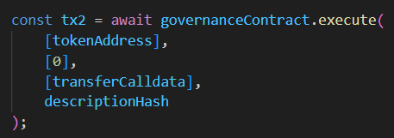
Proposal execution
Onchain Execution
Fair, automatic execution after locking period
  No need to trust an executor or errors in execution
  Used for high profile changes
Many token standards and extensions supporting vote counting methods.
Custom defined quorum mechanism.
Proposals are queued and time locked for some time after passing and before execution
Offchain Execution
Tally votes and an executor executes the action described in the proposal
- Do you trust the executor?
- Did the executor make a mistake?
Hybrid Execution
Proposal voting is onchain but robust discussions and developer meetings offchain in discussion forums.

Slide 27

Rage Quitting
If you do not agree with important proposals? DAO management paying themselves a comfortable salary out of the treasury?
Trade in your governance tokens for a part of the treasury.
Can be manipulated! Deliberately make bad decision, exit before effects take place. Therefore, rage quitting has the following conditions:
- Voted "yes" on active proposal: cannot withdraw until a certain time after implementation.
- Voted "no" or "abstain": can withdraw during grace period
Strangely attracts very loyal and passionate members?

Slide 28
Putting it all together
Notes:
Every device we have today is a turing machine and Ethereum operates on similar principles

Slide 29
DAO Technical Architecture
Token Type
Token Weight
Vote Eligibility
Distribution
Delegation
Token Tracking
Voting Strategy
Success Criteria
Proposal Queue
Proposal Execution
(Onchain)
Token Contract
Governance Contract
Token Management, Timelocking, Vote Tallying
Supporting Contract

